Slide 1
Title:DDoS Attack Detection Model

Slide 2
Motivation
By identifying the flow data associated with DoS attacks, the SOM technique is utilised to identify DoS attacks. This approach provides a high detection rate while using little energy. The extraction of the time period is the crucial component. This method's disadvantage is that the attack behaviour is not promptly and precisely identified, and the detection exhibits some hysteresis. In a large-scale network, the authors developed a framework for the detection and mitigation of DoS assaults, however it is not appropriate for deployment at a small scale. In, a genuine source and destination IP address database-based DoS attack detection system is suggested. It evaluates the anomalous properties of the source IP address and the destination using the non-parametric cumulative algorithm CUSUM.

Slide 3
Problem Statement
To Comparing the different Detection techniques for the DOS attack at a low rate, and finding the appropriate detection technique to mitigate the attack having low false rate.

Slide 4
Objective
Objective
• As most of the DOS attack detection system are triggered by high rate traffic.
• According to the characteristics of periodicity and short burst in DOS at a low rate ,it is hard to detect into the network.
• Comparing the different Detection techniques for the DOS attack at a low rate,and finding the appropriate detection technique to mitigate the attack having low false rate.

Slide 5
Scope
Smart grid has progressively become a widespread development trend in the global power business in recent years, and its security issues are becoming increasingly regarded by researchers. Physical con_x0002_trol, for example, has been used in smart grids. To increase their security, they use data encryption and authentication. However, timely and effective detection remains a problem. Strategies to keep the grid safe from cyber- attacks invasions that are malicious In order to address this issue, a model based on Machine learning has been used to detect smart grid DoS attacks.

Slide 6
Literature Review
sr.no | Paper Name | Author | Description
1. | Early Detection of DOS Attacks in VANET Using Attacked Packet Detection Algorithm (APDA) | S. RoselinMary, M. Maheshwari, M. Thamaraiselvan | The security of VANET (Vehicular Ad Hoc Networks) is crucial astheir very existence relates to critical life threatening situations. VANET is a sub_x0002_type of the MANET. In which the mobile nodes are all vehicles equipped with anOn-Board Unit (OBU) that enable them to send and to receive messages to the otherNodes in the network.. In this paper we proposed an Attacked Packet Detection Algorithm (APDA) which is used to detect the DOS (Denial-of_x0002_Service) attacks before the verification time. This minimizes the overhead delay for processing and enhances the security in VANET.
2. | IoT DoS and DDoS Attack Detection using ResNet | Faisal Hussain,Syed Ghazanfar Abbas, Muhammad Husnain,Ubaid U. Fayyaz, Farrukh Shahzad,Ghalib A. Shah | The network attacks are increasing both in frequency and intensity with the rapid growth of internet of things (IoT) devices. Recently, denial of service (DoS)and distributed denial of service (DDoS) attacks are reported as the most frequent at_x0002_tacks in IoT networks. The traditional security solutions like firewalls, intrusion de_x0002_tection systems, etc., are unable to detect the complex DoS and DDoS attacks sincemost of them filter the normal and attack traffic based upon the static predefinedrules. However, these solutions can become reliable and effective when integrated with artificial intelligence (AI) based techniques.
3. | Mitigation and Detection Strategy of DoS Attack on Wireless Sen_x0002_sor Network Using Blocking Approach and Intrusion Detection System | Faisal Mochamad Teguh Kurniawan, Setiadi Yazid Abdelrhman Mohammed, Iman Abuel Maaly Abdelrahman | Wireless Sensor Network (WSN) has a big role in several fields such as military, health and even information technology such as IoT Besides having many benefits, WSN has a disadvantage in its application where thereis no built-in security system embedded in the sensor device due to limitations possessed by sensor nodes such as memory, processor, and battery. As a result, WSN isvulnerable to attacks, one of the main attacks on WSN is the DoS attack. DoS attacksaim to prevent users legitimate from using resources by reducing existing resourcesuntil the network resources are busy, the network becomes slow until finally off. So,we need to detect, mitigate DoS attacks that these attacks can be stopped

Slide 7
4. | Event-triggered Switching-type Fault Detection and Isolation for Fuzzy Control Systems under DoS Attacks | Xiang-Gui Guo, Xiao Fan, Jian-Liang Wang, and Ju H. Park, | This paper investigates the memory adaptive eventtriggered (MAET) fault detection and isolation (FDI) problem for nonlinear networked controlsystems under periodic denial-ofservice (DoS) attacks, where the nonlinear systems are describedby Takagi–Sugeno (T–S) fuzzy models with unknown membership functions. First,a novel event-triggered mechanism is proposed to save communication resources.The triggering threshold is adaptively adjusted by multiple previous sampled data,not only depending on the latest triggering data. Second, taking DoS attacks and event-triggered mechanism into consideration, a switching state-feedback controller is established and the exponential stability is derived. Meanwhile, the controller andthe event-triggered mechanism are simultaneously developed based on a piecewiseLyapunov function.
5. | Thwarting DoS Attacks: A Framework for Detection based on Col_x0002_lective Anomalies and Clustering | Mohiuddin Ahmed | Information security is integral to any organization aiming to protect its intellectual property in the face of escalating and increasingly novel cyberattacks.1Among these, denial-ofservice (DoS) attacks—in which attackers typically send avolume of connection or information requests to overload the target system—haveearned the reputation as one of the most severe threats because they can shut downthe availability of a host, router, or even an entire network. The attacked system canbe forced out of service in as quickly as a few minutes and remain that way for days,forcing the victimized organization to incur significant losses. Additionally, a num_x0002_ber of toolkits for launching a DoS attack are freely available and easy to operate.2Compounding the problem is the growth of the Internet of Things (IoT), which isexpected to dramatically change the nature and size of DoS attacks.
6. | Implementation of SDN-based IDS to protect Virtualization Server against HTTP DoS attacks | Saifudin Usman, Idris Winarno, | Virtualization and Software-defined Networking (SDN) are emerging tech_x0002_nologies that play a major role in cloud computing. Cloud computing provides effi_x0002_cient utilization, high performance, and resource availability on demand. However,virtualization environments are vulnerable to various types of intrusion attacks thatinvolve installing malicious software and denial of services (DoS) attacks. Utilizing SDN technology, makes the idea of SDN-based security applications attractive in thefight against DoS attacks. Network intrusion detection system (IDS) which is usedto perform network traffic analysis as a detection system implemented on SDN networks to protect virtualization servers from HTTP DoS attacks.

Slide 8
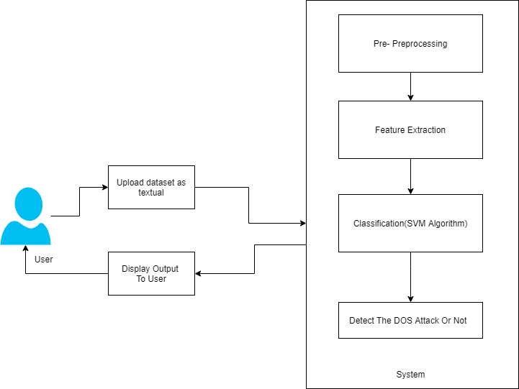
System Architecture

Slide 9
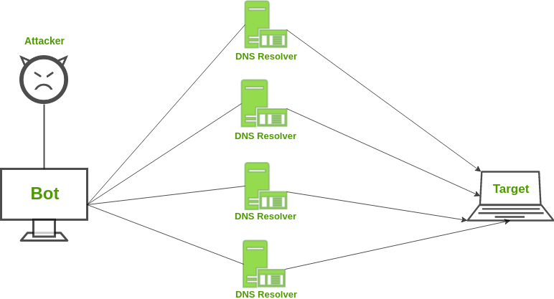

Slide 10
Software/Hardware Requirement
Software requirement:
Frontend Developement: Django
Backend Developement: Python
Programming Tools: Anaconda, Spyder, VStudio
Database: DBSqlite
Hardware requirement:
Hardware : intel core
Speed : 2.80 GHz
RAM : 8GB
HardDisk : 500 GB
Key Board: Standard Windows Keyboard
Operating System: Windows 10(64 Bit)

Slide 11
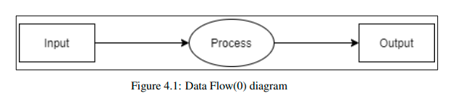
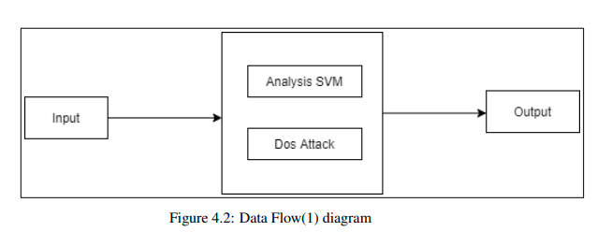
UML Diagrams

Slide 12
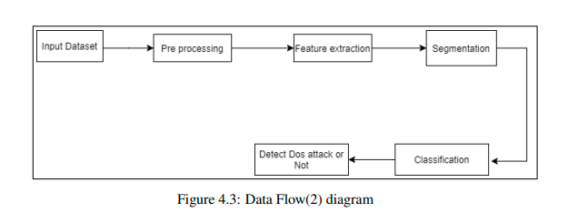

Slide 13
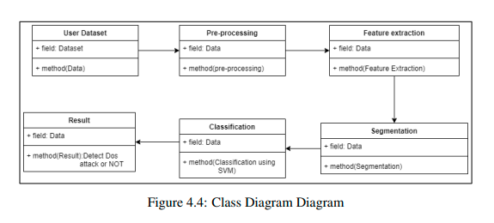
Class Diagram:

Slide 14
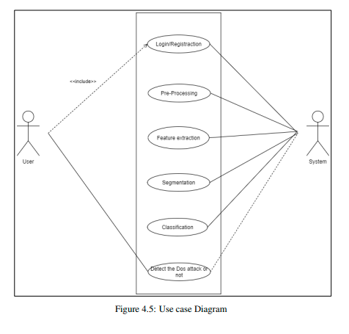
Use Case Diagram:

Slide 15
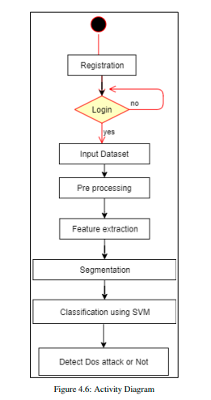
Activity Diagram:

Slide 16
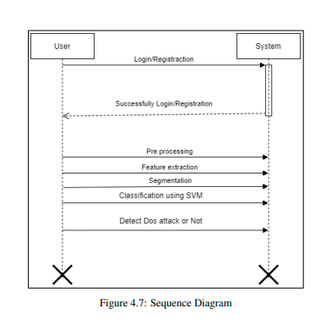
Sequence Diagram:

Slide 17
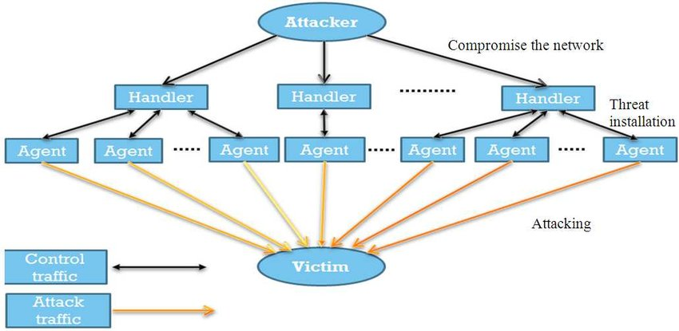
SRS Diagram:

Slide 18
Conclusion
This work provides a smart grid DoS attack detection methodology based on ma_x0002_chine learning to address the challenge of smart grid intrusion detection. In real time,the approach gathers network communication data between the smart metre and the data server. The SVM classifier trained model is used to identify and detect DoS as_x0002_saults by using feature selection and PCA dimension reduction to choose more representative features. The SVM classification model outperforms the Naive BayesianNetwork and Decision Tree classification algorithms on the KDD99 dataset. This method has a greater detection rate and accuracy for classification, which can helpto improve the smart grid’s security.

Slide 19
References
1]1 Vidyaev I G, Ivashutenko A S, Samburskaya M A. Smart Grid Concept As AModern Technology For The Power Industry Development[C]// 2017:012173.
2]Huang H B, Hong L, Chang-Yue Y U, et al. Analysis on Ukraine Power Grid Blackout and Its Enlightenment of ICS in China[J]. Standard Science, 2016.
3] Jianye Hao, Eunsuk Kang, Jun Sun, Zan Wang, “An Adaptive Markov Strat_x0002_egy for Defending Smart Grid False Data Injection from Malicious Attackers”,IEEE Transactions on Smart Grid. Sept. 2016.
4]Jiaxuan Fei,Tao Zhang,Yuanyuan Ma,Cheng Zhou. A DDoS attack detectionmethod for power grid industrial control system based on BF-DT-CUSUM al_x0002_gorithm[J]. Telecommunications Science.2015 (12).
5]Yanan Sun, Xiaohon Guan, Ting Liu, Yang Liu, “A cyber-physical monitoring system for attack detection in smart grid”, Computer Communications Work_x0002_shops (INFOCOM WKSHPS), 2013 IEEE Conference on, Turin, Italy, Dec.2014
6] Mina Rahbari and Mohammad Ali Jabreil Jamali, “Efficient Detection of SybilAttack Based on Cryptography in VANET,” IJNSA, Vol.3, No.6, November2011.
7] Mohamed Salah Bouassida, Gilles Guette, Mohamed Shawky, and BertrandDucourthial, “Sybil Nodes Detection Based on Received Signal Strength Vari_x0002_ations within VANET,” International Journal of Network Security, Vol.9, No.1

Slide 20
Introduction
The industrial industry is undergoing a dramatic transition as a result of the informa_x0002_tion era. In this context, the notion of smart grid arose as the times demanded, andit has since gained widespread recognition on a global scale, becoming a common development trend in the global power business. However, there have been instances of smart grid intrusion in the past. On January 6, 2016, for example, hackers attacked the Ukrainian electricity grid infrastructure, forcing hundreds of houses to turn off their lights. This is the first time in history that a cyber-attack has resulted in powerinterruptions. This cyber-attack on industrial control systems is unquestionably awatershed moment.

Slide 21
Support Vector Machine
Support Vector Machine or SVM is one of the most popular Supervised Learning algorithms, which is used for Classification as well as Regression problems. However, primarily, it is used for Classification problems in Machine Learning.The goal of the SVM algorithm is to create the best line or decision boundary that can segregate n-dimensional space into classes so that we can easily put the new data point in the correct category in the future. This best decision boundary is called a hyperplane.SVM chooses the extreme points/vectors that help in creating the hyperplane. These extreme cases are called as support vectors, and hence algorithm is termed as Support Vector Machine. Consider the below diagram in which there are two different categories that are classified using a decision boundary or hyperplane.
Two types Of SVM
Linear SVM: Linear SVM is used for linearly separable data, which means if a dataset can be classified into two classes by using a single straight line, then such data is termed as linearly separable data, and classifier is used called as Linear SVM classifier.
Non-linear SVM: Non-Linear SVM is used for non-linearly separated data, which means if a dataset cannot be classified by using a straight line, then such data is termed as non-linear data and classifier used is called as Non-linear SVM classifier

Slide 22
Software Defined Network
Software-defined networking (SDN) is an architecture that abstracts different, distinguishable layers of a network to make networks agile and flexible. The goal of SDN is to improve network control by enabling enterprises and service providers to respond quickly to changing business requirements.In a software-defined network, a network engineer or administrator can shape traffic from a centralized control console without having to touch individual switches in the network. A centralized SDN controller directs the switches to deliver network services wherever they're needed, regardless of the specific connections between a server and devices.This process is a move away from traditional network architecture, in which individual network devices make traffic decisions based on their configured routing tables. SDN has played a role in networking for a decade now and has influenced many innovations in networking.
SDN architecture
Typical representation of SDN architecture comprises three layers: the application layer, the control layer and the infrastructure layer.
i)Application Layer
ii)Control Layer
iii)Infrastructure Layer

Slide 23
i)Application Layer
The application layer contains the typical network applications or functions organizations use. This can include intrusion detection systems, load balancing or firewalls. Where a traditional network would use a specialized appliance, such as a firewall or load balancer, a software-defined network replaces the appliance with an application that uses a controller to manage data plane behavior.
ii)Control Layer
The control layer represents the centralized SDN controller software that acts as the brain of the software-defined network. This controller resides on a server and manages policies and traffic flows throughout the network.
iii)Infrastructure Layer
The infrastructure layer is made up of the physical switches in the network. These switches forward the network traffic to their destinations.

Slide 24
Smart grid DOS intrusion
Smart grid network architecture consists of three layers.
i) Home area network-Home area network is a devoted network which is at thebottom layer of the Smart Grid. It is the network totally which connects all devices in the home. To monitor and control these appliances separate software applications can be deployed. In Smart Grid sector it is the most upcoming area to serve all the utilities and vendors. Home area network consist of smart meter and metering module.
ii)Neighbourhood area network-Middle layer is Neighborhood Area Network (NAN) which connects the bottom layer through a range of small networkscalled community networks. This network transfers the datacollected from all the surrounding devices which again sends these collected data to the next layer. It sends and receives data in duplex format.
iii)Wide area network-Top layer is Wide Area Network which connects the main parts of the network like power plants, substations, and all other grid devices. This network connects a number of smart grid networks and forms an integrated smart grid network.Since it has an interconnected environment it can support various applications and solve their requirements. The applications include Supervisory Control And DataAcquisition (SCADA)

Slide 25
Advantages,Limitations and Application
Advantages
Having a predictable, steady, effective and reliable form of DDoS protection saves money.
It reduces operational and capex costs by not having to outsource its protection to a third party scrubbing center, or hire additional IT security staff, or purchase addi_x0002_tional bandwidth capacity
Disadvantages
Coarse grain filtering also hitting legitimate traffic
Cannot completely eliminate the malicious traffic.
Difficult to detect all malicious.
Application
Application layer DDoS attacks are designed to attack the application itself, focusing
on specific vulnerabilities or issues, resulting in the application not being able to
deliver content to the user.

Slide 26
Thank You

